Slide 1
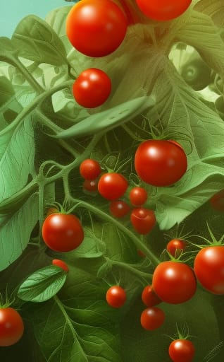
Image Classification using Deep Learning with real Farm Application
Saroj Rimal
SID: 210144664
Saroj.rimal@yorksj.ac.uk

Slide 2
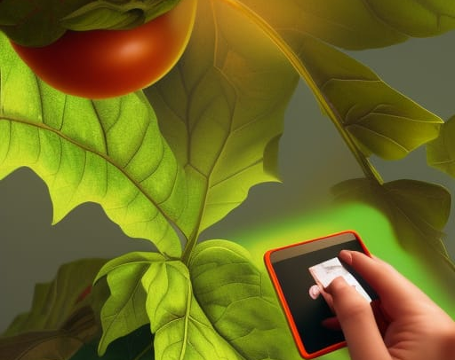
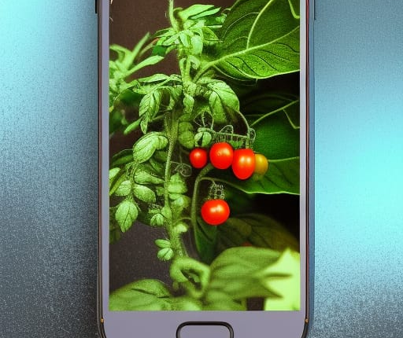
Introduction
This project aims to at utilizing deep learning techniques to classify tomato plant leaf images and identify various diseases affecting tomato plants. With the increasing demand for efficient and accurate disease detection in agriculture, this project focuses on developing a Convolutional Neural Network (CNN) model that can accurately classify and diagnose tomato leaf diseases.
The main objective of this project is to leverage the power of deep learning algorithms, specifically CNN, to train a model that can effectively classify different types of tomato plant diseases based on leaf images. By utilizing a large dataset of tomato leaf images, the CNN model learns to extract intricate patterns and features that distinguish healthy leaves from those affected by diseases.
The trained CNN model will be capable of analyzing unseen tomato leaf images and accurately predicting the specific disease or indicating the absence of any disease. This technology has significant implications for the agricultural industry, as it enables early detection and timely intervention, leading to improved crop management and higher crop yields.
By combining advanced deep learning techniques with real-world farm applications, this project aims to contribute to the development of intelligent agricultural systems that can efficiently identify and mitigate the impact of tomato leaf diseases. The successful implementation of this image classification system will empower farmers and agronomists with a powerful tool to monitor and manage plant health, ultimately leading to enhanced crop productivity and sustainability in the agricultural sector.

Slide 3
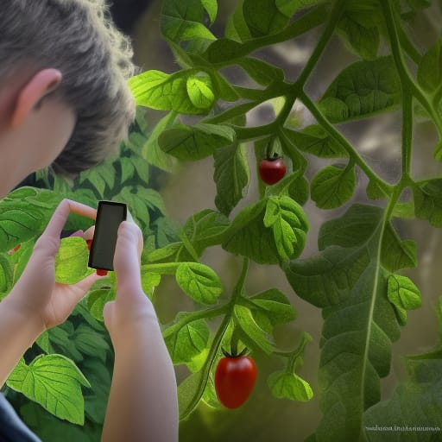
Purpose of the study
Research aim:
From gathering the problem scenario and after analysing the various critics, this dissertation specially aims to enhance the effectiveness of Convolutional Neural Networks in image classification by building a real-life mobile application for classifying tomato plant disease.
Objectives:
To explore the working mechanism of deep-learning algorithms for image classification
To Analyse the effectiveness of CNN with Data Augmentation and Image Data Generator.
To build a neural network model that can classify image with high performance and accuracy.
To analyse and implement faster data transfer between deep learning model and web/mobile application.
To Build a mobile app to detect tomato disease.

Slide 4
Methodology
This study primarily uses quantitative research methodology, relying on experimental evaluation and statistical analysis to test hypotheses and draw conclusions about the most effective CNN architecture for image classification.
For the product development, Agile methodology is followed as it is iterative approach and flexible for the production.
The workflow of this project starts with data collection, then choosing the CNN approaches (Data Augmentation or Image Data Generator) and proceeding for data cleaning and preprocessing. Then, that cleaned dataset is forwarded to built the CNN model where it is trained using two mentioned approaches.
The trained CNN model is then converted into TFLite model using Tensorflow converter using Quantization.
Finally, the TFLite model is deployed into android mobile application.

Slide 5
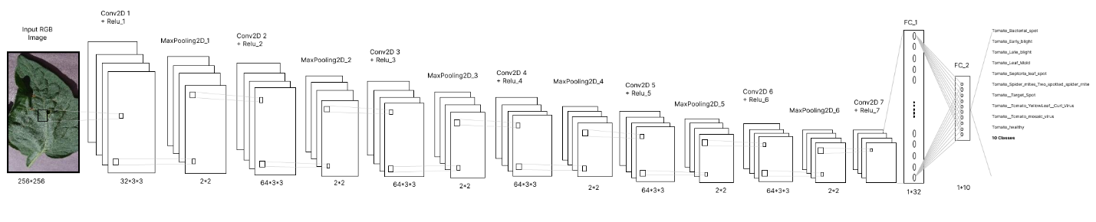
Working Mechanism of CNN
The CNN model used for tomato plant image classification has a specific input shape requirement:
a batch size of 32, RGB image resolution of 256x256 pixels, and 3 colour channels.
It is designed to classify the images into 10 different classes. The CNN architecture includes Conv2D layers with 32 filters and a kernel size of 3x3, followed by ReLU activation for introducing non-linearity.
MaxPooling2D layers with a pool size of 2x2 are added after each convolutional layer to reduce the spatial dimension of the feature maps.
A Flatten layer is used to convert the 2D feature maps into a 1D vector.
Two Dense layers are added, with the first layer having 64 units and ReLU activation, and the second layer having a number of units equal to the number of classes (10) and using softmax activation for multi-class classification.

Slide 6

Tools And Technology
S. N | Hardware/Software | Specification
1 | CPU | Intel® Core™ i7-4720HQ
2 | GPU | Nvidia GeForce GTX 960M
3 | Processor | Intel core i7 8th generation
4 | RAM | 8 GB
5 | Operating system | Microsoft Windows 10 Enterprise
6 | Programming Language | Python version 3.11, JAVA
7 | Libraries used | NumPy, Pandas, matplotlib, Seaborn, Tensorflow, Keras
8 | Platform used | Jupyter Notebook, Android Studio

Slide 7
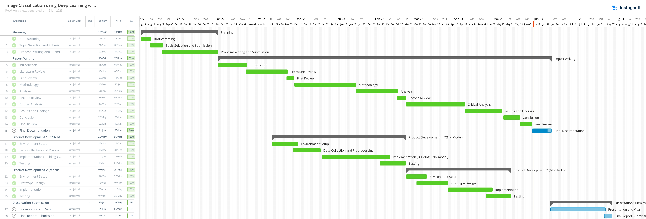
Timeline

Slide 8
Result and Analysis: Part 1
The two CNN approaches are built, compared and analyzed on the basis off different evaluation metrics.
CNN model with Data Augmentation (DA) outperforms the CNN with Image Data Generator (IDG) with the training accuracy of 97.04% and 98.12% validation accuracy. Likewise, it has the lowest value for training and validation loss that means the model is performing well.
However, this model took more time to train the model i.e., 3:21 hour for 20 epochs.
Metrix | CNN with DA | CNN with IDG
Accuracy | 97% | 96%
Precision | 98% | 92%
Recall | 97% | 92.90%
F1 Score | 97% | 92.80%
Training Time (h:m) | 3:21 | 3:3
Epochs | 15 | 20

Slide 9
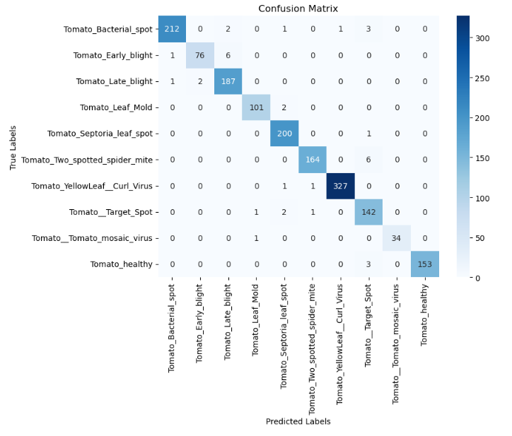
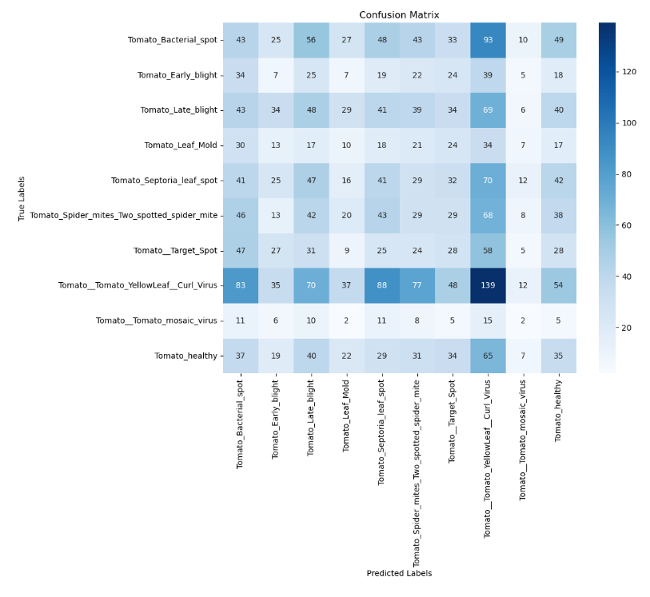
Part 2: Confusion Matrix
Here, the confusion matrix of CNN model with DA shows impressive results with every class successfully classifying more True Positive values.
On the other hand, CNN model with IDG has lots of misclassification as per the confusion matrix.
CNN model with DA
CNN model with IDG

Slide 10
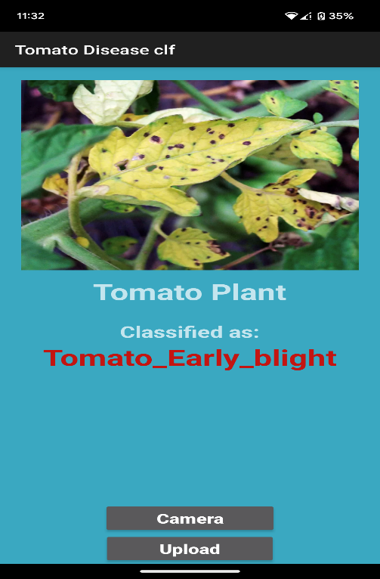
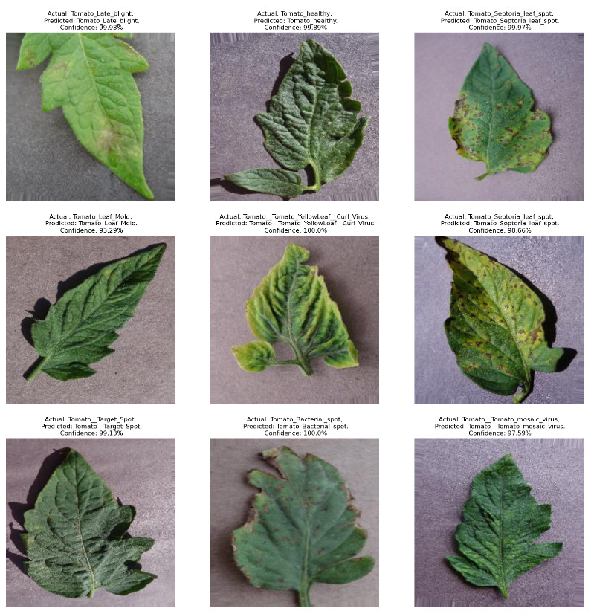
Part 3: Final output
Final Mobile App
Prediction by Model
The left side figure represents the model’s prediction with actual and predicted name along with confidence level, i.e., accuracy.
On the right side, there is the final output of this project where the tomato plant disease is classified through mobile devices.

Slide 11
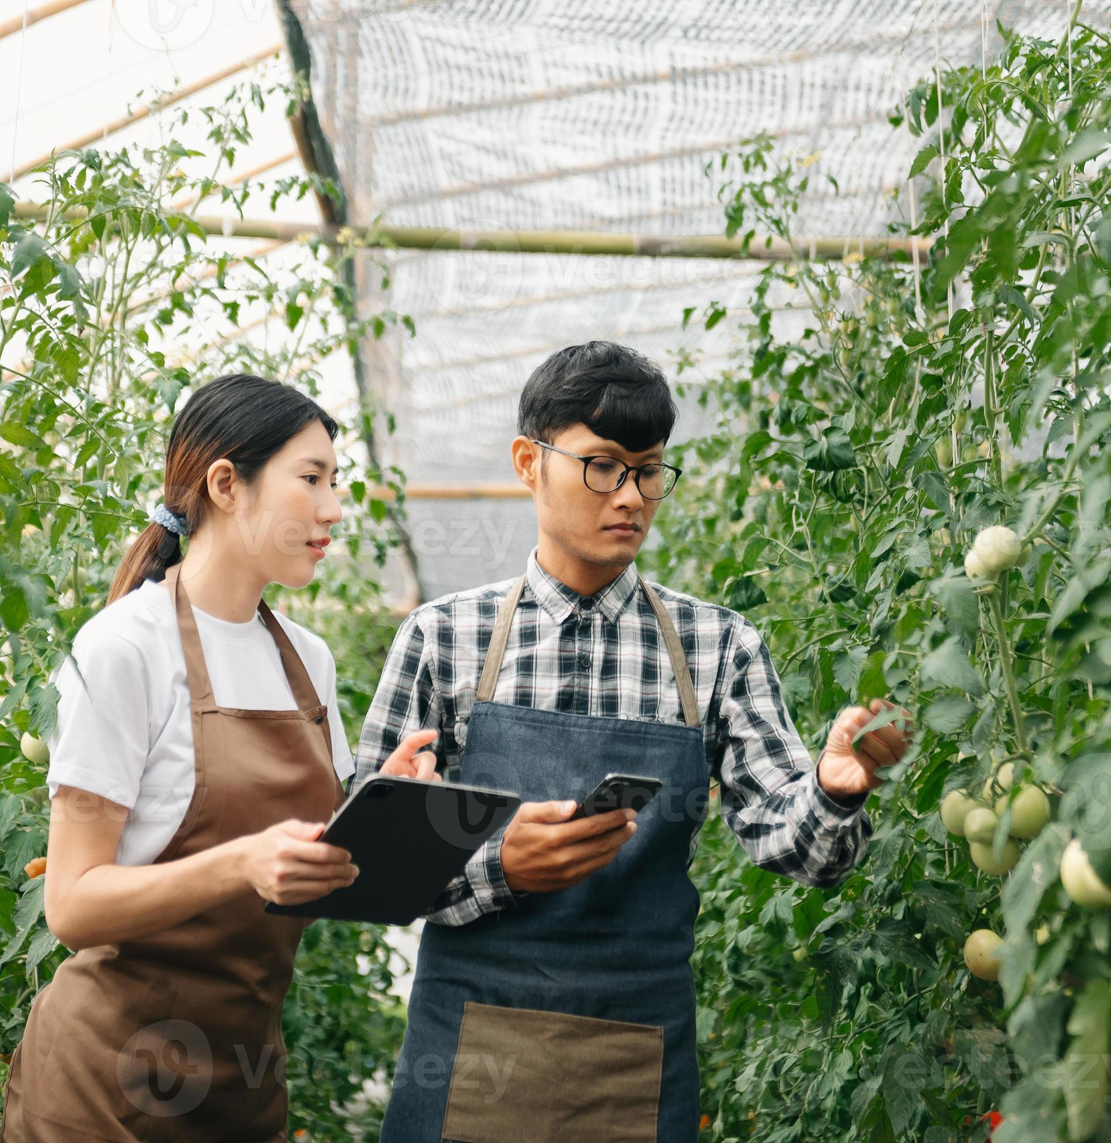
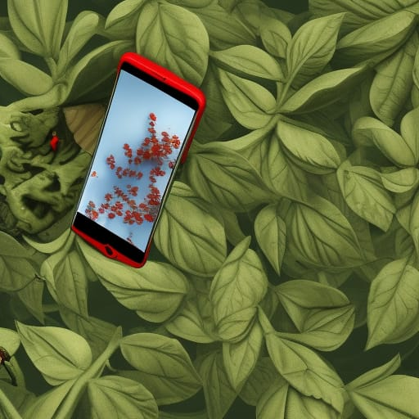
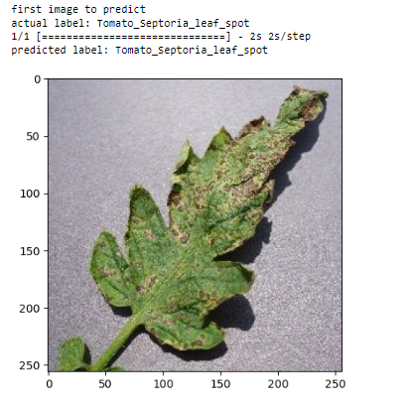
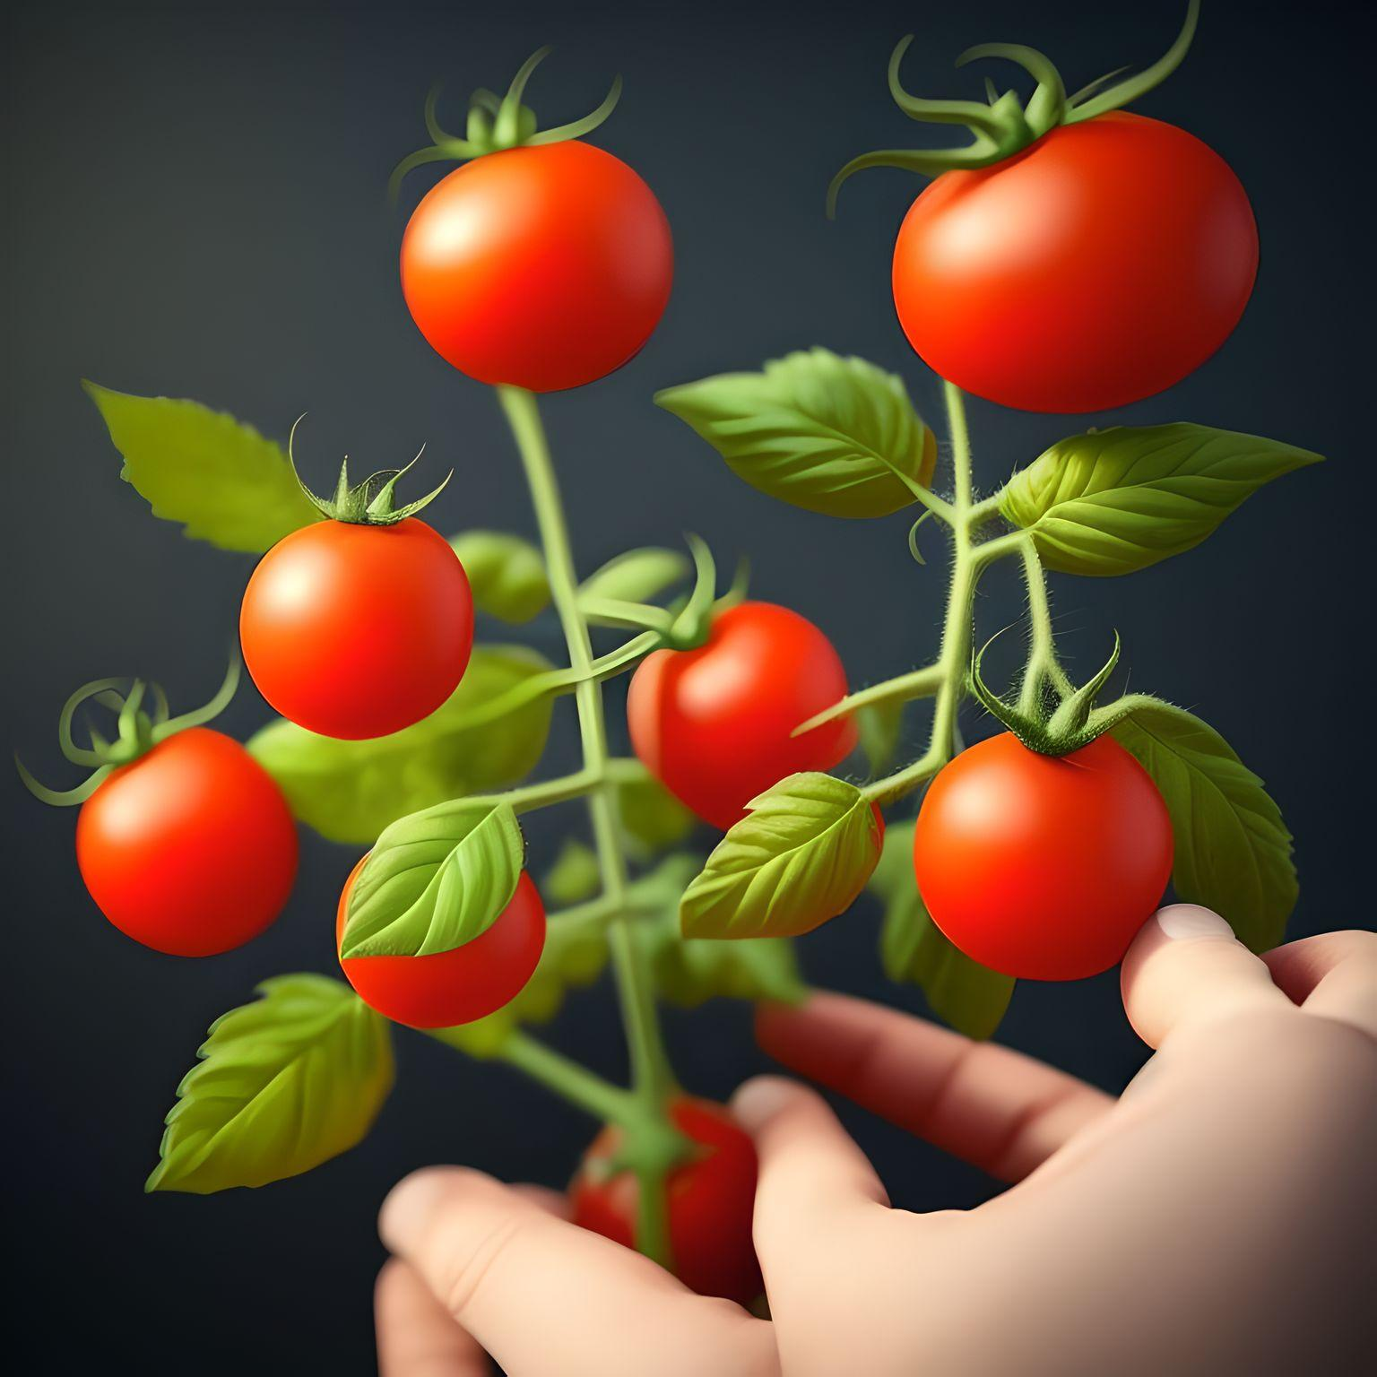
Conclusion
In conclusion, this study successfully developed and tested two CNN models: one with Data Augmentation and another with Image Data Generator. The effectiveness and performance of data augmentation and Image Data Generator were evaluated using testing image samples and new unseen images.
Both models were trained and evaluated using the same dataset, which was split into training, validation, and testing sets. Accuracy, precision, f1-score, and recall were measured and compared for evaluation purposes. Additionally, the confusion matrix, number of epochs used for training, and training time were considered. Due to the limited computational resources, the training time for the CNN models was relatively longer.
Data augmentation proved to be a valuable technique, particularly when dealing with limited or unbalanced datasets. It enhanced the model's performance by introducing variations and helping it learn more reliable characteristics, thus minimizing overfitting. The model with data augmentation achieved the highest accuracy compared to the Image Data Generator.
Overall, this study provides valuable insights and practical implications for utilizing CNN models in plant disease classification tasks, and it contributes to the advancement of deep learning techniques in agriculture and mobile applications.

Slide 12
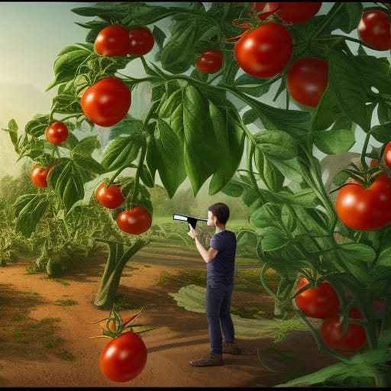
Future Works
Explore and experiment with other pre-trained CNN models to potentially improve classification performance and speed up results delivery.
Implement common testing approaches such as cross-validation and hyperparameter tuning to comprehensively evaluate the model's performance and ensure its robustness.
Investigate the use of cloud platforms like Google Cloud Platform (GCP), Amazon Web Services (AWS), and Azure for deploying the CNN model into mobile applications, enabling efficient data transmission, quick response times, and cloud storage for data.
Develop a web application that displays the classification results and incorporates visualization and analytics tools for in-depth analysis of the collected data, including identifying highly affected plants by diseases.
Enhance the mobile application by displaying the confidence level alongside the actual and predicted disease names and provide recommendations and remedies specific to each type of disease.

Slide 13

Reference
Gill, H.S & Khehra, B.S, 2022. An integrated approach using CNN-RNN-LSTM for classification of fruit images. Materials Today: Proceedings, pp. 591-595.
Gu, S., Pednekar, m. & Slater, R., 2019. Improve image classification using data augmentation and neural networks. SMU Data Science Review, 2(2), p. 1.
Haque, I. & Neubert, J., 2020. Deep learning approaches to biomedical image segmentation. Informatics in Medicine Unlocked, 1 Jan, p. 100297.
Jasim, M. & Al-Tuwaijari, J., 2020. Plant leaf diseases detection and classification using image processing and deep learning techniques. In 2020 International Conference on Computer Science and Software Engineering (CSASE), 16 Apr, pp. 259-265.
Jaswal, D., Sowmya & Soman, K. P., 2014. Image Classification Using Convolutional Neural Networks. International journal of scientific and engineering research, , 5(6), pp. 1661-1668.
Korytkowski, M, Rutkowski, L & Scherer, R, 2016. Fast image classification by boosting fuzzy classifiers. Information Sciences, Volume 327, pp. 175-182.
Kothari, D., Patel, M. & Sharma, A., 2021. Implementation of Grey Scale Normalization in Machine Learning & Artificial Intelligence for Bioinformatics using Convolutional Neural Networks. 6th International Conference on Inventive Computation Technologies (ICICT), 20 Jan, pp. 1071-1074.

Slide 14
Thank You
Any Questions !!!
Saroj Rimal
Saroj.rimal@yorksj.ac.uk
210144664

